Slide 1
Trans-Pacific Partnership
Consulate General of Japan in Miami
2016
As of March 29, 2016

Slide 2
General Overview
TPP OVERVIEW
Free Trade Area of 800 Million People
Represents nearly 40% of Global GDP
Represents 33% of total Global Trade
12 Asia-Pacific countries including Japan and US signed TPP on February 4th, 2016
with ratification process to follow
* Some Asian Countries already Expressed Interest to join
CHAPTERS
Trade in Goods: Elimination of more than 18,000 tariffs and limiting non-tariff barriers that discriminate
Labor: enforce i.l.o. labor standards**
Environment: Combat wildlife trafficking and promote higher environmental standards**
Trade Facilitation: Harmonization of Rules, Regulations and Procedures; and common Rules of Origin
Competition: Level Playing-Field for Private Sector vs. State-Owned Companies
Intellectual Property Rights: Stronger protection for patents, trademarks and copyrights
E-Commerce: Facilitate Internet-based commerce, protect digital freedom, and preserve open Internet access**
Investment Rights: Protecting foreign Investment and strengthen Rule-of-Law
SME’s: streamline technical and administrative procedures to access new markets
Services: reducing barriers and protection allowed only for positive list of services
Dispute Resolution: resolve disputes through an independent tribunal
(**) Not Covered by WTO Agreements
Source: U.S.T.R. (2015)
2

Slide 3
Economic Benefits of TPP for U.S. (1)
TPP Countries account for 45% of Total U.S. Goods Exports
3.1 Million U.S. Jobs supported by Goods Exported to TPP Countries
1.1 Million U.S. Jobs supported by Service Exports to TPP Countries
--------------------------------------------------------------------------------------------------------------------------------------------------------------------------------------------------------------------------------------
Levels the Playing Field for U.S. Industry & Supports Jobs
reduction of tariffs, opening markets and equal/favorable treatment to foreign investors and service providers will boost exports, solidify economic growth, and create jobs in U.S.
Source: U.S.T.R. (2015)

Slide 4
Economic Benefits of TPP for U.S. (2)
Eliminate 99.9% on more than 18,000 tariffs
on U.S. Goods Exports
Ensuring Foreign Regulations and Agricultural Inspections based on science, eliminating export subsidies, and minimizing unpredictable export bans.
Strong and balanced rules that Protect U.S. exports of Intellectual Property-related products and services and enable the full potential of scientific, technological and medical innovation
Provide Protection of U.S. Investments against discrimination and uncompensated expropriation of property, improve the cross-border flow of capital, and ensure a transparent and rules-based investor-state dispute settlement mechanism
Source: U.S.T.R. (2015)

Slide 5
Particular benefits for SMEs
Small-to-Medium Size Enterprises (SMEs)
Stand to Benefit From Expedited clearing process
Assist Small Businesses Integrate in Global Supply chains
Access to Information for Free Trade utilization
SME Committee to provide recommendations to enhance TPP benefits
Electronic Commerce
Unlock the potential of E-Commerce
Maintain the internet free and open
Promote competitive access for telecomm suppliers
Set digital trade rules
Source: U.T.S.R. (2015)

Slide 6
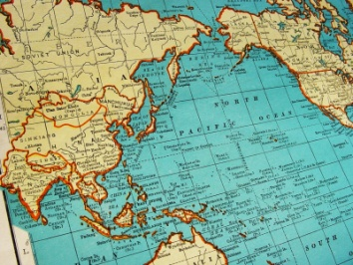
Strategic Importance of tpp
Maintain U.S-Japan leadership role in the global trading system by helping write the rules.
Solidifies the U.S.-Japan security Alliance
and economic relationship
Support Peace and Stability in the
Asia-Pacific Region
Promote a Rule-Based Economic System and Transparency

Slide 7
Japan – U.S. economic relations
Japan is the 5th largest overseas market for combined U.S. goods and services, valued at $115 billion
Japan is the 4th largest overseas market for exports of agricultural and manufactured goods, valued at $67 billion
Japan is the 3rd largest overseas market for U.S. services exports, valued at $47 billion
Japan is the 2nd largest foreign investors in the U.S., contributing to 720,000 jobs with an average wage of $79,000
Source: U.S.-Japan Business Council (2015)

Slide 8
FLORIDA – TPP PARTNERS
1,300+ Florida companies are subsidiaries of companies from TPP countries.
Nearly 942,000 jobs in Florida are supported by trade with TPP countries.
22% of Florida goods exported overseas are bound for TPP countries.
Florida exported $12.5 billion worth of goods to TPP countries (out of total of $58.5 Billion)
Source: Business Roundtable (2015)
Source: Florida Ports Council (2015)

Slide 9
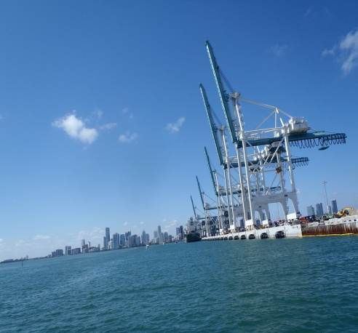
FLORIDA-JAPAN (trade)
Total Florida Goods & Services Exports = $4.1 billion
Total Florida-Origin Goods Exports = $1.1 billion
Source: Business Roundtable (2015)
Japan is the largest export market for Florida Grapefruits
** gradual reduction of 10% tariff to zero within six years **
With the Panama Canal Expansion, TPP will increase cargo traffic benefitting Florida’s ports
** Florida’s 15 Deepwater Seaports support 700,000 jobs (directly and indirectly) and account for 11.5% of the state’s economy **
FLORIDA EXPORT SECTORS TO BENEFIT
From TPP
Aviation/Aerospace
Telecommunications
Pharmaceuticals
Computer Hardware & Software
Agriculture & Agricultural Inputs

Slide 10
Japanese investments in Florida
Japan historically the largest source of Foreign Investment in terms of property, plant, and equipment Florida valued at $4.11 billion
195 Japanese-owned companies support nearly 25,900 jobs in the state
Growing interest in direct air service
Source: Enterprise Florida (2015)

Slide 11
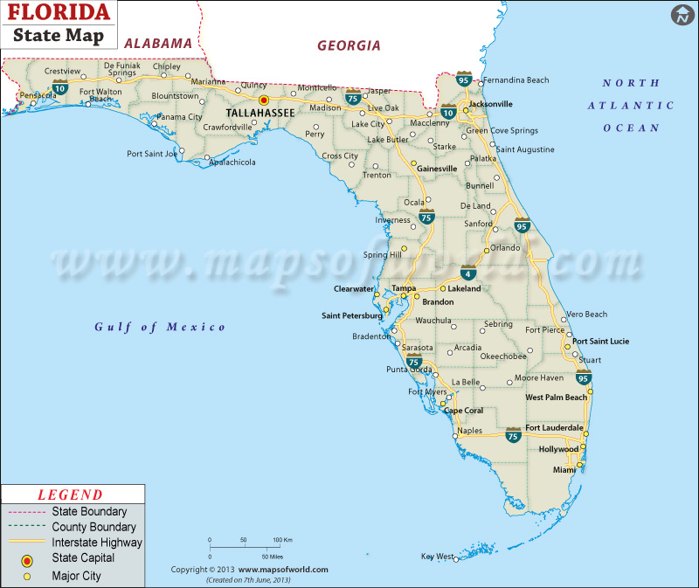
Major Japanese Companies in Florida
TraPac / Mitsui O.S.K. Lines
NTT Data
Pilot Corporation of America
Employs 240 people
Hitachi Cable
Employs 320 people
Terumo BCT
Mitsubishi Heavy Industries
Mitsukoshi
Mitsubishi Hitachi Power Systems
Employs 1050 Floridians
ASO Corporation
Employs 250 people
TBC Corporation
Canon Inc.
SATO Global Solutions
Crystal Mover Services
Brightstar / SoftBank
Sony Latin America / Sony Pictures
Mason Vitamins / Ito-En
NSK Limited
Noven Pharmaceutical / Hisamitsu Pharmaceutical
Employs over 450 people

